Slide 1
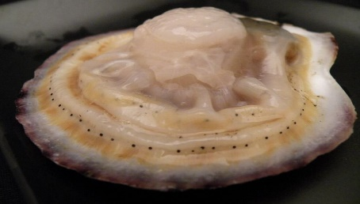
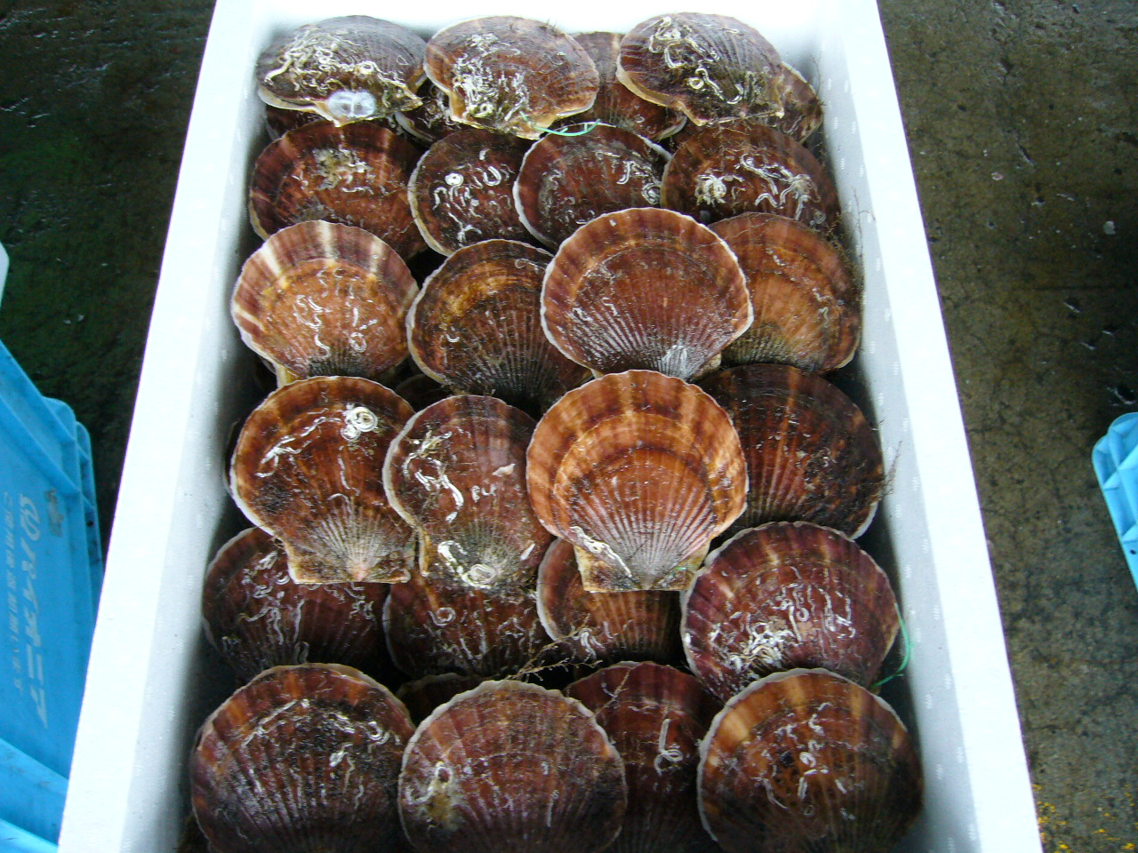
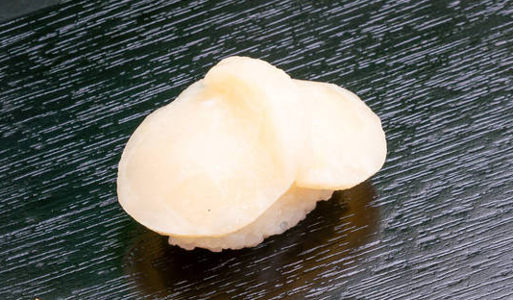
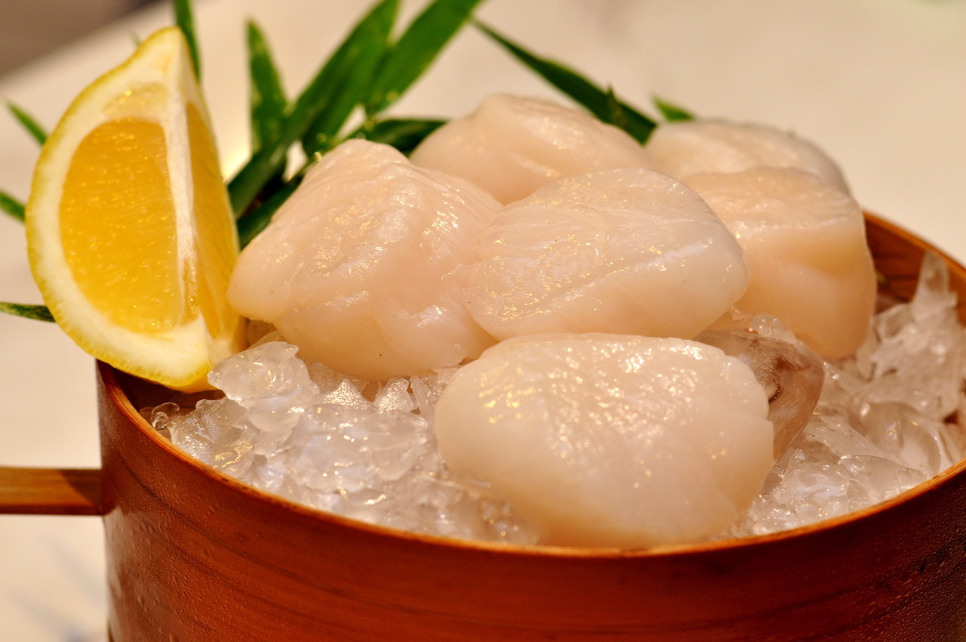
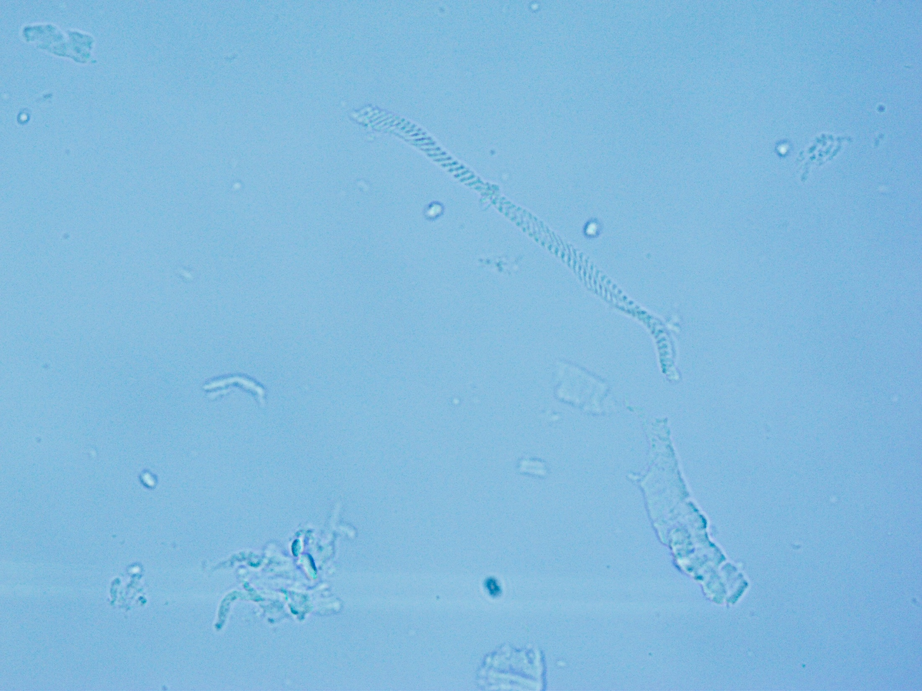
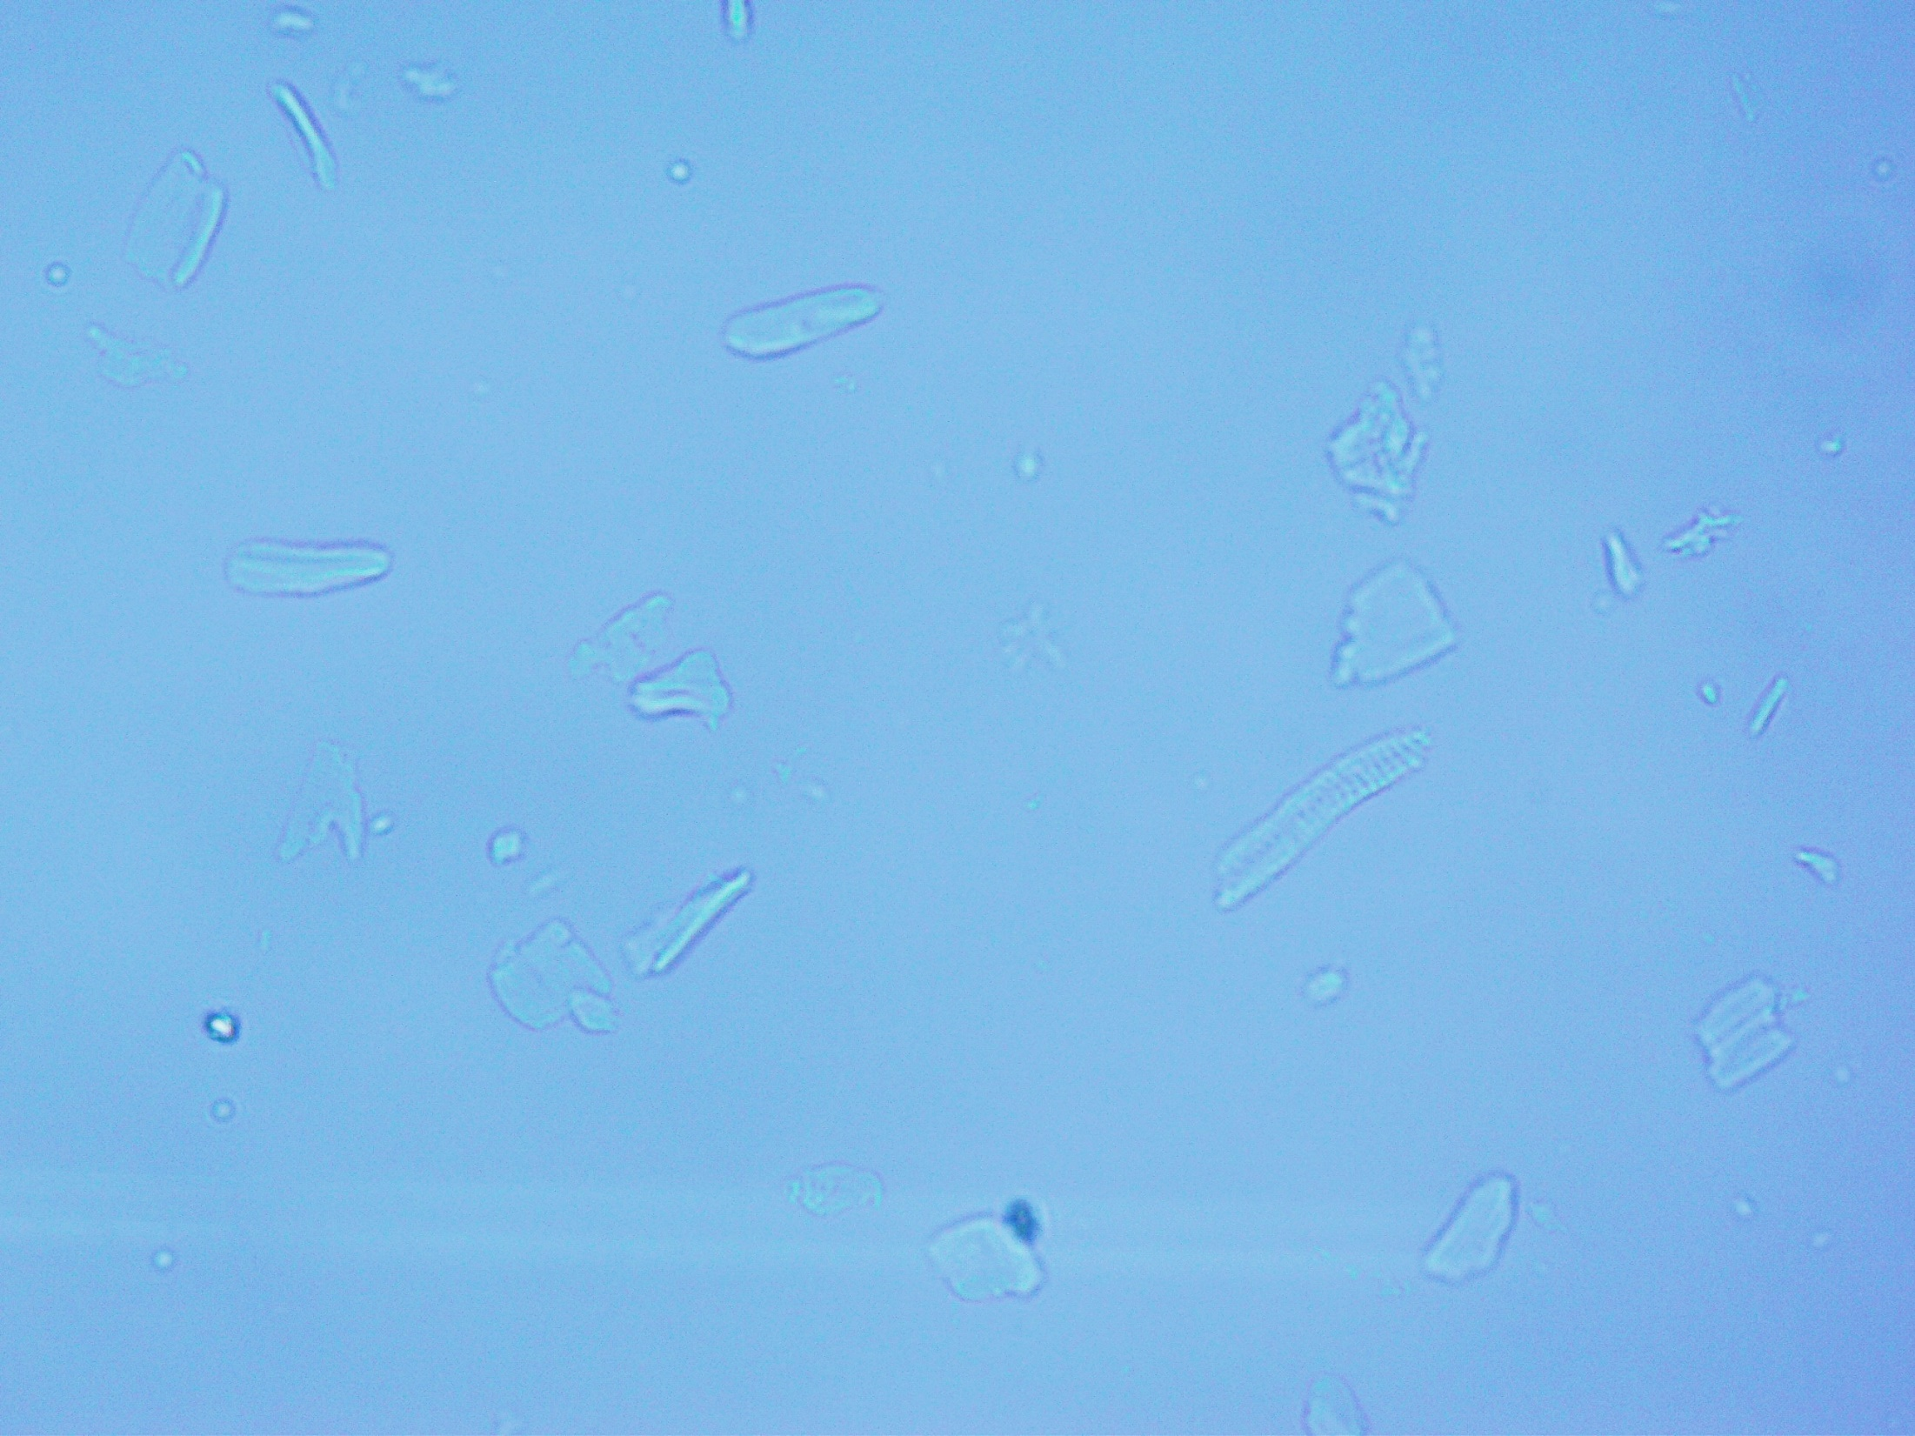
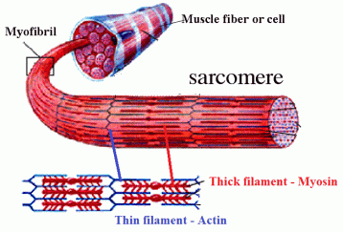
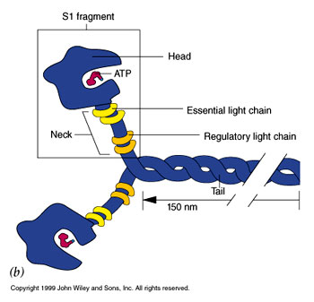
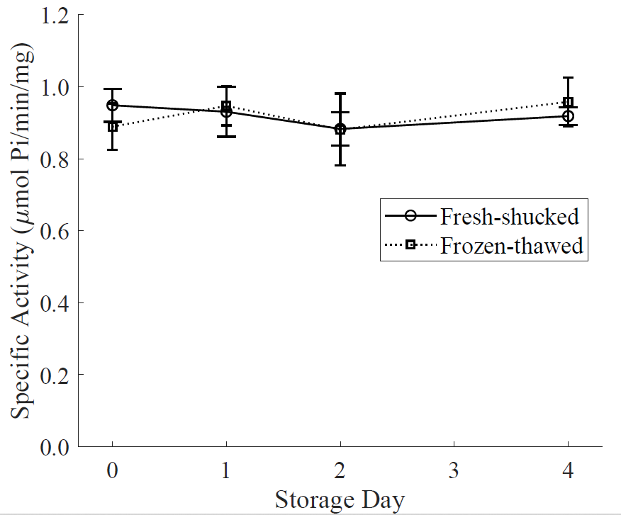
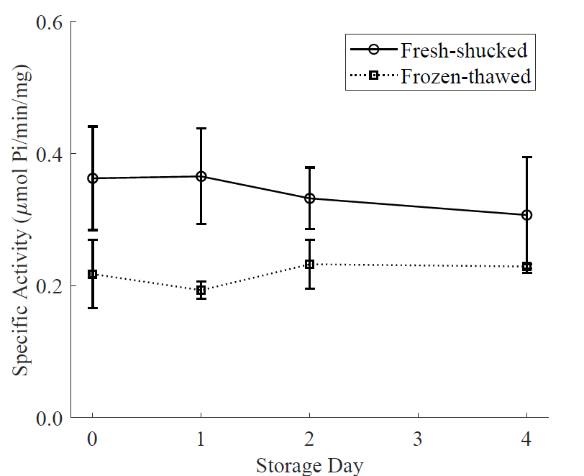
Study on Biochemical and Sensorial Changes of Fresh and Frozen-thawed Scallop Adductor Muscle as Raw Materials for Sashimi during Cold Storage
The East Asia Fisheries Technologists Association
EAFTA
No.PS21811
EAFTA 2023
Yabin Niu¹ Shiliang Dong¹ Naoto Shimakage² Huamao Wei³ Kefeng Yu⁴ Chunhong Yuan*² Koichi Takaki⁵
1 United Graduate School of Agricultural Sciences, Iwate University, Ueda 3-18-8, Morioka, Iwate 020-8550, Japan 2 Faculty of Agriculture, Iwate University, Ueda 3-18-8, Morioka, Iwate 020-8550, Japan 3 College of Food and Pharmaceutical Sciences, Ningbo University, Ningbo, Zhejiang 315211, China | 4 Sanriku Fisheries Research Center, Iwate University, Heta 3-75-1, Kamaishi, Iwate 026-0001, Japan 5 Faculty of Science and Engineering, Iwate University, Ueda 4-3-5, Morioka, Iwate 020-8551, Japan
May 17-20, 2023
Contact Information: niu0125@yeah.net
Introduction
Results
QIM scheme for fresh and frozen-thawed scallop adductor muscle
Yesso scallop
(Mizuhopecten yessoensis)
Significant differences (p＜0.05) after freezing and thawing
Quality parameter | Description | Score
Appearance | Bright white | 0
 | Lack of luster, milky white | 1
 | Slightly dim, light yellow | 2
 | Dim and yellow | 3
Odor | Fresh smell | 0
 | Neutral, little fishy smell | 1
 | Slight off-flavor | 2
 | Strong off-flavor | 3
Texture | Strong fibrous sensation, chewy | 0
 | A little fibrous, lack of chewiness | 1
 | No fibrous sensation or | 2
 | Sticky, very soft, no need to bite | 3
Taste | Pleasant taste, soft sweetness | 0
 | Slight sweetness and fishy taste, umami taste | 1
 | A little bitter and saline taste, slightly sour taste, no sweetness | 2
 | Strong bitter and sour taste | 3
Quality Index (0-12)
Best quality
Frozen scallop adductor muscle
Sensory evaluation (quality index method)
Frozen-thawed scallop adductor muscle can be happily accepted on day 0~1
Freezing can be regarded as an available method for long-distance transportation.
Fresh scallops
Storage days | Samples | Appearance | Odor | Texture | Taste | Total score | Acceptability (%)
0 | Fresh Frozen-thawed | 0^{c} 0.14±0.38^{c} | 0^{c} 0^{c} | 0^{d} 1.14±0.69^{c} | 0^{d} 0.43±0.53^{cd} | 0e 1.71±0.76^{d} | 100 100
1 | Fresh Frozen-thawed | 0.71±0.49^{b} 0.57±0.53^{bc} | 0.14±0.38^{c} 0.29±0.49^{bc} | 0.86±0.38^{c} 1.71±0.49^{b} | 0.71±0.49^{c} 1^{bc} | 2.43±1.13^{d} 3.57±0.53^{c} | 100 100
2 | Fresh Frozen-thawed | 1.57±0.53ª 0.86±0.38^{b} | 0.71±0.49^{b} 0.71±0.49^{b} | 1.00±0.58^{c} 2^{ab} | 1.14±0.38^{bc} 1.29±0.49^{b} | 4.43±0.98^{c} 4.86±0.69^{bc} | 85.7 71.4
4 | Fresh Frozen-thawed | 1.57±0.53ª 0.86±0.38^{b} | 1.57±0.79ª 1.29±0.49ª | 1.29±0.49^{bc} 2.43±0.53ª | 1.29±0.49^{b} 2.14±0.69ª | 5.71±0.95^{b} 6.71±1.11ª | 42.8 0
Lower quality
Sushi
Sashimi
The acceptance of frozen-thawed scallop adductor muscle decreased to 0 on day 4, but the microbial index of that sample was still within the acceptable range (＜10⁵ CFU/g)
Freezing
Merits:
Long distance transportation
Prolong the shelf life
Problems:
Quality deterioration
Sensorial differences
Aim
QIM was performed by seven trained panelists (ages: 20~50 years, males: n = 4, females: n = 3)
The percentage in the column of acceptability indicates the proportion of trained panelists who think the scallop adductor muscle can be happily accept
To consider the biochemical and sensorial changes of fresh and frozen-thawed scallop adductor muscle during storage at 4 ℃;
To prepare for studying quality maintenance of frozen scallop adductor muscle.
The microscopic observation of myofibrils
ATP-related compounds
Fresh-Day 0
Frozen-thawed-Day 0
Fresh
Frozen-thawed
Conclusions
Method
The microstructure of the scallop adductor muscle was damaged after freezing and thawing.
QIM can be used as an effective method to evaluate scallop adductor muscle as raw materials for sashimi
Suitable indicators to differentiate fresh and frozen-thawed scallop adductor muscle: the microscopic observation of myofibrils, ATP-related compounds, pH value
Fresh-shucked
ATP and ADP remained stable
ATP (≈ 50%) on day 4
Few HxR & Hx were detected
Frozen-thawed
ATP decreased to 5% on day 0
HxR (≈ 40%) and Hx (≈ 20%) after storage for 4 days
Experimental flowchart
50 μm
50 μm
The live scallops (n = 60) were obtained from the Kamaishi scallop aquaculture company, Iwate, Japan in November 2019 - January 2020
The example of myofibrils is shown in the rectangular box, and the example of small unopened clumps is shown in the circle.
0
1
0
1
0
1
0
1
The number in the circle represents the storage days
ATPase activity
Schematic model of myofibril and myosin
positive significance
4
2
4
2
4
2
4
2
ATPase activity
The quality control of frozen scallop adductor muscle for long-distance transportation
Fresh group
Frozen-thawed group
The decline of pH value was accompanied by ATP degradation.
The changes of ATP-related compounds and pH value during storage can be regarded as indicators to differentiate fresh and frozen-thawed scallop adductor muscle.
Frozen at -60℃, thawed in ice water
pH value
Soaked in sterilized seawater for 20 min
Ca²⁺-ATPase activity
Mg²⁺-ATPase activity
Acknowledgements
The authors gratefully acknowledge the funding support of Japan Society for the Promotion of Science (19H05611).
Packed into a sampling bag individually
Aa
Aa
Aa
Aa
Aa
Aa
Aa
Aa
Aa
Aa
Aa
Aa
Kept at 4 ℃ for 0~4 days
Sensory evaluation (Triangle test & Quality index method)
Microscopic observation of myofibrils
Ca²⁺-ATPase activity
Mg²⁺-ATPase activity
ATP related compounds
pH value
References
Ab
Ab
Aa
Aa
Fresh
Almost unchanged after storage for four days
Higher than 7.0
Frozen-thawed
Decreased rapidly to 6.3
Kept stable gradually
Kawashima, K., & Yamanaka, H. (1995). Effect of freezing and thawing on post-mortem biochemical changes in scallop adductor muscle. Fisheries science, 61(4), 691-695.
Konno, K. (2017). Myosin Denaturation Study for the Quality Evaluation of Fish Muscle-based Products. Food Science and Technology Research, 23(1), 9-21
Leygonie, C., Britz, T. J., & Hoffman, L. C. (2012). Impact of freezing and thawing on the quality of meat: review. Meat Sci, 91(2), 93-98.
Wei, H., Tian, Y., Yamashita, T., Ishimura, G., Sasaki, K., Niu, Y., & Yuan, C. (2020a). Effects of thawing methods on the biochemical properties and microstructure of pre-rigor frozen scallop striated adductor muscle. Food Chem, 319, 126559.
https://andreacollo.wordpress.com/tag/myofibril
Freshness analysis
No significant differences (p > 0.05)
Significant differences (p ˂ 0.05) at the initial days of cold storage (day 0~1)
Storage Day
The interaction between myosin and actin could be weakened by the freezing and thawing process.
The head region of myosin remained stable.

